Slide 1



Register transfer and microoperations
Noida Institute of Engineering and Technology, Greater
Noida
Unit: 2
COMPUTER SYSTEM
ORGANIZATION (AMCA-0104)
Mr. LAKSHM JI
MCA-I SEM
Dr. RAJ KUMAR GOEL
AMCA-0104
UNIT-2
1
1/19/2022

Slide 2

Content
➢ Register Transfer Language
➢ Register Transfer
➢ Bus and Memory Transfers
➢ Common Bus System
➢ Multiple Bus organization (Two and Three)
➢ Microoperations (Arithmetic, Logic and Shift)
➢ Arithmetic & Logic unit design
1/19/2022
Dr. RAJ KUMAR GOEL
AMCA-0104
UNIT-2
2

Slide 3

Course Objective
➢ Discuss the basic concepts of register and register transfer
language.
➢ Understand concepts of register transfer logic and arithmetic
operations.
➢ Explain different types of bus architecture and bus arbitration concepts.
➢ To discuss different types of memory, memory mapping and memory management hardware.
1/19/2022
Dr. RAJ KUMAR GOEL
AMCA-0104
UNIT-2
3

Slide 4

COs
CO1: Master the number systems including computer arithmetic, logic gates, Boolean algebra, Minimization techniques etc.
CO2: Be familiar with the construction of buses by using different digital components and memory related concepts.
CO3: Be familiar with the functional units of the processor such as the register file, arithmetic‐logical unit and control unit.
CO4: Be familiar with the Input-Output subsystem and protocols
for data communication.
CO5: Be familiar with the cache subsystem, memory mapping
techniques, paging techniques and segmentation.
1/19/2022
Dr. RAJ KUMAR GOEL
AMCA-0104
UNIT-2
4

Slide 5

POs
PO1:Computational Knowledge: Develop knowledge of computing fundamentals, computing specialization, mathematics and domain knowledge for solving real world problems.
PO2:Problem Analysis: Identify formulate review research literature and analyze complex problems reaching substantial conclusions using first fundamental principles of mathematics, computing science and relevant domain discipline.
PO3:Design /Development of Solutions: Ability to design and evaluate system, components or processes for complex computing problems that meets specified needs with appropriate consideration for the public health and safety and cultural societal and environmental consideration.
PO4:Conduct investigations of complex Computing problems: Use research-based knowledge and research methods including design of experiments, analysis and interpretation of data, and synthesis of the information to provide valid conclusions.
PO5: Modern Tool Usage: Create, select, adapt and apply appropriate techniques, resources, and modern computing tools including prediction and modeling to complex computing activities, with an understanding of the limitations.
PO6:Professional Ethics: Understand and commit to professional ethics and cyber regulations,
responsibilities, and norms of professional computing practices.
1/19/2022
Dr. RAJ KUMAR GOEL
RCA-403
UNIT-1
5

Slide 6

Pos Cont..
PO7:Life-long Learning: Recognize the need, and have the ability, to engage in independent learning for continual preparation and development as a computing professional for broadest content of technological change.
PO8:Project management and finance: Demonstrate knowledge and understanding of the computing and management principles and apply these to one’s own work, as a member and leader in a team, to manage projects and in multidisciplinary environments.
PO9:Communication Efficacy: Communicate effectively with the computing community, and with society at large, about complex computing activities by being able to comprehend and write effective reports, design documentation, make effective presentations, and give and understand clear instructions.
PO10:Societal and Environmental Concern: Understand and assess societal, environmental, health, safety, legal, and cultural issues within local and global contexts, and the consequential responsibilities relevant to professional computing practices.
PO11:Individual and Team Work: Function effectively as an individual and as a member or leader in diverse teams and in multidisciplinary environments.
PO12: Innovation and Entrepreneurship: Identify a timely opportunity and using innovation to pursue that opportunity to create value and wealth for the betterment of the individual and society at large.
•
1/19/2022
Dr. RAJ KUMAR GOEL
RCA-403
UNIT-1
6

Slide 7

CO-PO Mapping
Mapping of COs and POs
POs | PO1 | PO2 | PO3 | PO4 | PO5 | PO6 | PO7 | P8 | PO9 | PO 10 | PO 11 | PO 12
COs
CO1 | 3 | 3 | 2 | 2 | 2 |  |  | 3 | 3
CO2 | 3 | 3 | 2 | 3 | 2 |  |  | 3 | 3
CO3 | 3 | 2 | 3 | 3 | 3 |  |  | 3 | 3
CO4 | 2 | 3 | 3 | 2 | 3 |  |  | 3 | 3
CO5 | 3 | 2 | 3 | 3 | 3 |  |  | 3 | 3
1 – Week
2- Moderate
3 – Strong
Dr. RAJ KUMAR GOEL
AMCA-0104
UNIT-1
7

Slide 8

Prerequisite and Recap
➢ Before learning the concepts of Basic Electronics and Computer Organization, you should have a basic knowledge of functional units of a computer system.
➢ The basic knowledge of mathematics.
➢ The knowledge of English language upto a satisfactory level.
➢ In the previous unit we have discussed about the number systems, conversion among bases, representation of numbers, combinational and sequential circuits with examples and minimization methods of boolean expressions
Dr. RAJ KUMAR GOEL
AMCA-0104
UNIT-2
8

Slide 9

Topic
➢ Register transfer and Register transfer language
1/19/2022
Dr. RAJ KUMAR GOEL
AMCA-0104
UNIT-1

Slide 10

Topic objective
➢ To discuss about register transfer language,
transfer and bus architecture.
bus and memory
1/19/2022
Dr. RAJ KUMAR GOEL
AMCA-0104
UNIT-1

Slide 11
Topic objective
➢ To discuss about fundamental concepts of register, register transfer
and arithmetic and logic operations.
Dr. RAJ KUMAR GOEL
AMCA-0104
UNIT-3

Slide 12

Fundamental Concepts (CO2)
➢ Registers are a type of computer memory used to quickly accept, store, and transfer data and instructions that are being used immediately by the CPU.
➢ The registers used by the CPU are often termed as Processor registers.
➢ A processor register may hold an instruction, a storage address,
or any data (such as bit sequence or individual characters).
Dr. RAJ KUMAR GOEL
AMCA-0104
UNIT-3

Slide 13
Fundamental Concepts (CO2)
➢ The computer needs processor registers for manipulating data and a register for holding a memory address.
➢ The register holding the memory location is used to calculate the address of the next instruction after the execution of the current instruction is completed.
Dr. RAJ KUMAR GOEL
AMCA-0104
UNIT-3

Slide 14

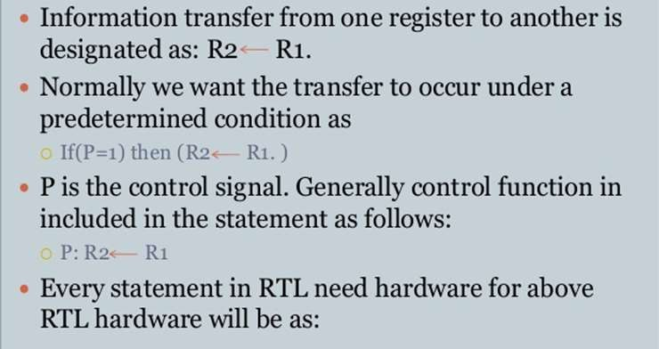
Register Transfers(CO2)
Dr. RAJ KUMAR GOEL
AMCA-0104
UNIT-3

Slide 15
Performing arithmetic or logical operations (CO2)
Arithmetic Operations
Example | Description
R3 ← R1 + R2 | Addition
R3 ← R1 - R2 (R1 + R2' + 1) | Subtraction
R2 ← R2' | Complement (really a logic operation)
R2 ← -R2 (R2' + 1) | Negation
R1 ← R1 + 1 | Increment
R1 ← R1 - 1 | Decrement
Dr. RAJ KUMAR GOEL
AMCA-0104
UNIT-3

Slide 16
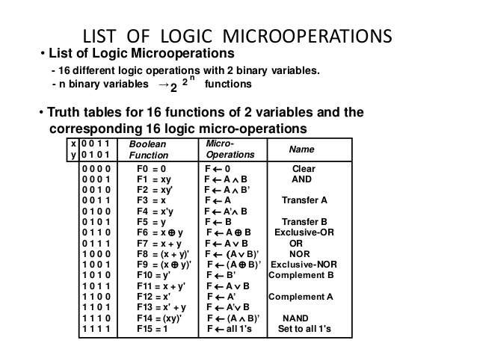
Performing arithmetic or logical operations(CO2)
Dr. RAJ KUMAR GOEL
AMCA-0104
UNIT-3

Slide 17

Daily Quiz
1. Design an arithmetic circuit with one selection variable S and two n-bit data inputs A and B. The circuit generates the following four arithmetic operations in conjunction with the input carry C_{in}. Draw the logic diagram for the first two stages.
S | C_{in} = 0 | C_{in} = 1
0 | D=A+B (ADD) | D=A+1 (INCREMENT)
1 | D = A-1 (DECREMENT) | D=A+B’+1 (SUBTRACT)
Dr. RAJ KUMAR GOEL
AMCA-0104
UNIT-3

Slide 18

Recap
In the last lecture we have discussed about
Concepts of register, register transfer and arithmetic and logic operations.
Dr. RAJ KUMAR GOEL
AMCA-0104
UNIT-3

Slide 19
Topic objective
➢ To discuss about fetching and storing words from memory, execution steps of a complete instruction.
Dr. RAJ KUMAR GOEL
AMCA-0104
UNIT-3

Slide 20
Fetching and storing words from memory (CO2)
➢ The transfer of information from a memory word to the outside environment is called a read operation.
➢ Read: DR ← M [AR]
➢ The transfer of new information to be stored into the memory is called a write operation.
➢ Write: M [AR] ← DR
Dr. RAJ KUMAR GOEL
AMCA-0104
UNIT-3

Slide 21
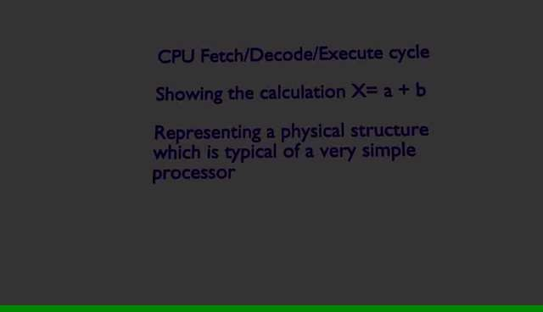
Fetching and storing words from memory (CO2)
Dr. RAJ KUMAR GOEL
AMCA-0104
UNIT-3

Slide 22
Execution of a complete instruction (CO2)
➢ The program is executed in the computer by going through a cycle for each instruction.
➢ Each instruction cycle in turn is subdivided into a sequence of sub
cycles or phases.
➢ In the basic computer each instruction cycle consists of the
following phases:
1. Fetch an instruction from memory.
2. Decode the instruction.
3. Read the effective address from memory if the instruction has an
indirect address.
4. Execute the instruction
Dr. RAJ KUMAR GOEL
AMCA-0104
UNIT-3

Slide 23

Multiple-Bus organization (CO2)
Multiple Bus Organization
➢ An alternative structure is the two bus structure, wherein two different internal buses are used in the central unit. All register outputs are connected to the bus A, add all registered entries are connected to the bus B.
➢ Because the two buses are used here, the temporary register Z is not necessary here, which is used in the organization of single bus to store the result of the ALU.
➢ Now, the result can be transferred directly to the bus B, as one of the inputs is disabled bus A. With the bus link, the result can be directly transferred to the destination register.
Dr. RAJ KUMAR GOEL
AMCA-0104
UNIT-3

Slide 24
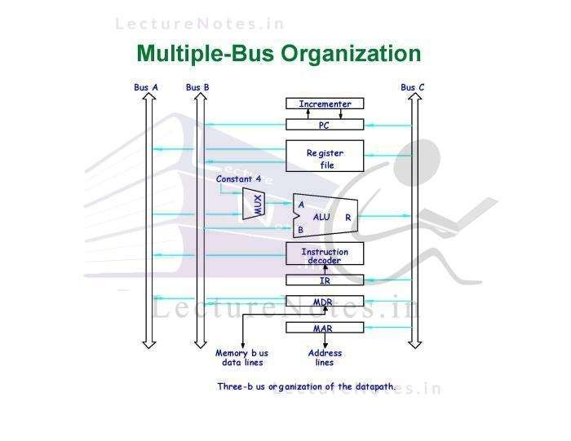
Multiple-Bus organization (CO2)
Dr. RAJ KUMAR GOEL
AMCA-0104
UNIT-3

Slide 25
Daily Quiz
1. Write steps for execution of instructions.
2. Explain two and three bus organization.
Dr. RAJ KUMAR GOEL
AMCA-0104
UNIT-3

Slide 26
Recap
In the last lecture we have discussed about
➢ Fetching and storing words from memory, execution steps of
a complete instruction.
Dr. RAJ KUMAR GOEL
AMCA-0104
UNIT-3

Slide 27

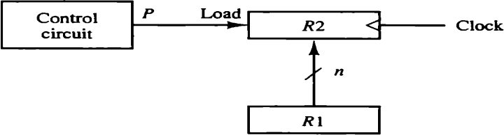
Register Transfer Language(CO2)
➢ The symbolic notation used to describe the microoperation transfers among registers is called a register transfer language.
➢ The term "register transfer" implies the availability of hardware logic circuits that can perform a stated microoperation and transfer the result of the operation to the same or another register.
➢ Information transfer from one register to another is designated in symbolic form by means of a replacement operator.
Figure : Transfer from R1 to R2 when P = 1
Dr. RAJ KUMAR GOEL
AMCA-0104
UNIT-2

Slide 28

Bus and Memory Transfers (CO2)
➢ Typical digital computer has many registers, and paths must be provided to transfer information from one register to another.
➢ The number of wires will be excessive if separate lines are used between each register and all other registers in the system.
➢ A more efficient scheme for transferring information between registers in a multiple-register configuration is a common bus system.
➢ A bus structure consists of a set of common lines, one for each bit of a register, through which binary information is transferred one at a time
Dr. RAJ KUMAR GOEL
AMCA-0104
UNIT-2

Slide 29
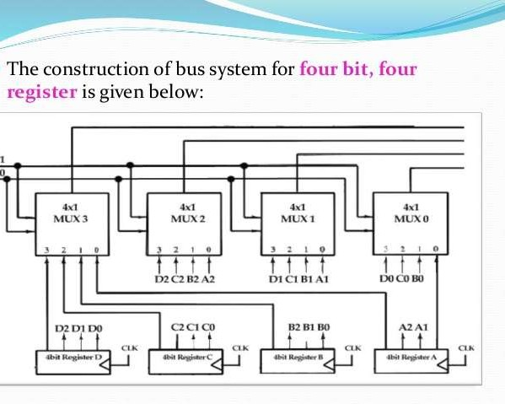
Bus and Memory Transfer Cont.. (CO2)
Figure 2.2 Bus system for four registers
Dr. RAJ KUMAR GOEL
AMCA-0104
UNIT-2

Slide 30
Bus and Memory Transfer Cont.. (CO2)
One way of constructing a common bus system is with multiplexers. The multiplexers select the source register whose binary information is then placed on the bus. The construction of a bus system for four registers is shown in Fig. Each register has four bits, numbered 0 through 3. The bus consists of four 4 x 1 multiplexers each having four data inputs, 0 through 3, and two selection inputs, S1 and S0. In order not to complicate the diagram with 16 lines crossing each other, we use labels to show the connections from the outputs of
th1/1e9/20r22egisters to thDer. RAiJnKUMpARuGOtEsL ofAMtChA-0e104muUlNtITi-p2
lexers.
30

Slide 31
Bus and Memory Transfer Cont.. (CO2)
For example, output 1 of register A is connected to input 0 of MUX 1 because this input is labeled A1. The diagram shows that the bits in the same significant position in each register are connected to the data inputs of one multiplexer to form one line of the bus. Thus MUX 0 multiplexes the four 0 bits of the registers, MUX 1 multiplexes the four 1 bits of the registers, and similarly for the other two bits.
Dr. RAJ KUMAR GOEL
AMCA-0104
UNIT-2

Slide 32
Bus and Memory Transfer Cont.. (CO2)
Select Lines combination S1S0 | Register Selected
00 | Register A
01 | Register B
10 | Register C
11 | Register D
Dr. RAJ KUMAR GOEL
AMCA-0104
UNIT-2

Slide 33
Bus and Memory Transfer Cont.. (CO2)
The number of multiplexers needed to construct the bus is equal to the number of bits in each register. The size of each multiplexer must be 'k * 1' since it multiplexes 'k' data lines. For instance, a common bus for eight registers of 16 bits each requires 16 multiplexers, one for each line in the bus. Each multiplexer must have eight data input lines and three selection lines to multiplex one significant bit in the eight registers.
Dr. RAJ KUMAR GOEL
AMCA-0104
UNIT-2

Slide 34
Bus and Memory Transfer Cont.. (CO2)
Question. A digital computer has a common bus system for 16 registers of 32 bit each. The bus is constructed with multiplexers.
(i) How many selection input are there in each multiplexers.
(ii) What size of multiplexers are needed.
(iii) How many multiplexers are there in the bus.
Dr. RAJ KUMAR GOEL
AMCA-0104
UNIT-2

Slide 35
Bus and Memory Transfer Cont.. (CO2)
Question. A digital computer has a common bus system for 16 registers of 32 bit each. The bus is constructed with multiplexers.
(i) How many selection input are there in each multiplexers.
(ii) What size of multiplexers are needed.
(iii) How many multiplexers are there in the bus.
Ans.
(i) 4 selection lines to select one of 16 registers
(ii) 16x1 multiplexers
(iii) 32 multiplexers one for each bit of the registers.
Dr. RAJ KUMAR GOEL
AMCA-0104
UNIT-2

Slide 36
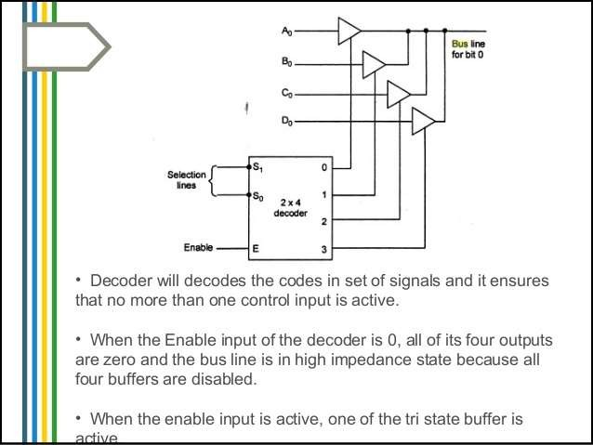
Bus and Memory Transfer Cont.. (CO2)
Figure : Bus system for four registers
Dr. RAJ KUMAR GOEL
AMCA-0104
UNIT-2

Slide 37

Daily Quiz
1. Describe various notations and their use in register
transfer language.
2. What do you mean by a Bus?
Dr. RAJ KUMAR GOEL
AMCA-0104
UNIT-2

Slide 38

Recap
In the last lecture we have discussed about
1. Definition of register transfer and register transfer
language
2. Construction of bus by using multiplexers and three
state buffers
Dr. RAJ KUMAR GOEL
AMCA-0104
UNIT-2

Slide 39
Topic
➢ Bus architecture and bus arbitration
Dr. RAJ KUMAR GOEL
AMCA-0104
UNIT-1

Slide 40
Topic objective
➢ To discuss about single and multiple bus architectures.
Dr. RAJ KUMAR GOEL
AMCA-0104
UNIT-1

Slide 41

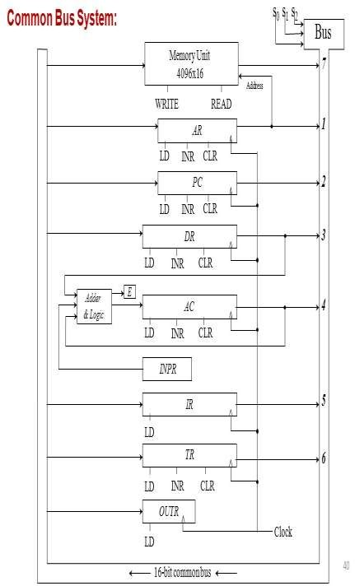
Bus Architecture (CO2)
➢ The basic computer has eight registers, a memory unit, and a control unit.
➢ Paths must be provided to transfer information from one register to another and between memory and registers.
➢ The number of wires will be excessive if connections are made between the outputs of each register and the inputs of the other registers.
➢ A more efficient scheme for
transferring system with
information in a many registers
1_{i}/_{s}19/_{t}2_{o}022_{use a common bu}D_{s}r..RAJ KUMAR GOEL
AMCA-0104
UNIT-2
41

Slide 42

Bus Arbitration
➢ Bus Arbitration refers to the process by which the current bus master accesses and then leaves the control of the bus and passes it to another bus requesting processor unit.
➢ The controller that has access to a bus at an instance is known as a Bus master
Dr. RAJ KUMAR GOEL
AMCA-0104
UNIT-2

Slide 43

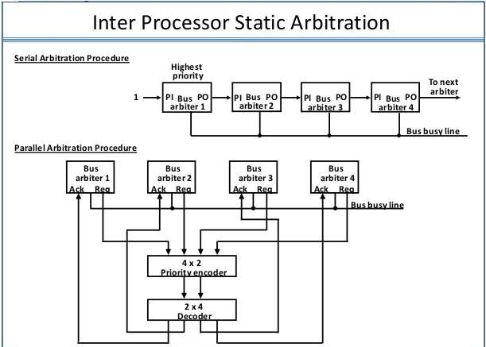
Bus Arbitration (CO2)
Figure : Serial and parallel arbitration
Dr. RAJ KUMAR GOEL
AMCA-0104
UNIT-2

Slide 44
Daily Quiz
1. How many types of Buses are there in our computer
system?
2. What is Daisy chaining?
Dr. RAJ KUMAR GOEL
AMCA-0104
UNIT-2

Slide 45
Recap
In the last lecture we have discussed about
Register transfer language, bus and memory transfer and bus architecture.
Dr. RAJ KUMAR GOEL
AMCA-0104
UNIT-2

Slide 46
Topic
Arithmetic, logic and shift microoperations
Dr. RAJ KUMAR GOEL
AMCA-0104
UNIT-2

Slide 47

Topic objective
To discuss about arithmetic, logic and shift microoperations,
their hardware construction and construction of fast adders.
Dr. RAJ KUMAR GOEL
AMCA-0104
UNIT-2

Slide 48
Arithmetic, Logic & Shift Microoperations
Definition: A microoperation is an elementary operation performed with the data stored in registers.
The microoperations most often encountered in digital computers are classified into four categories:
➢ Register transfer microoperations – transfer binary
information from one register to another
➢ Arithmetic microoperations – operations on numeric
data
➢ Logic microoperations – perform bit manipulation
operations
➢ Shift microoperations – perform shift operations
Dr. RAJ KUMAR GOEL
AMCA-0104
UNIT-2

Slide 49

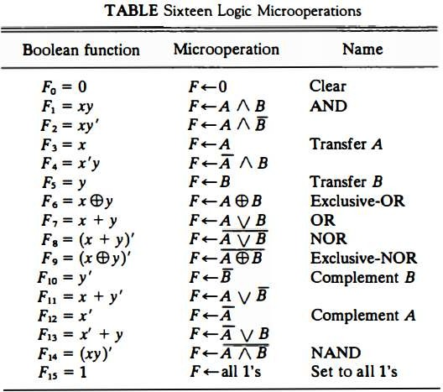
Logic Microoperations
Dr. RAJ KUMAR GOEL
AMCA-0104
UNIT-2

Slide 50

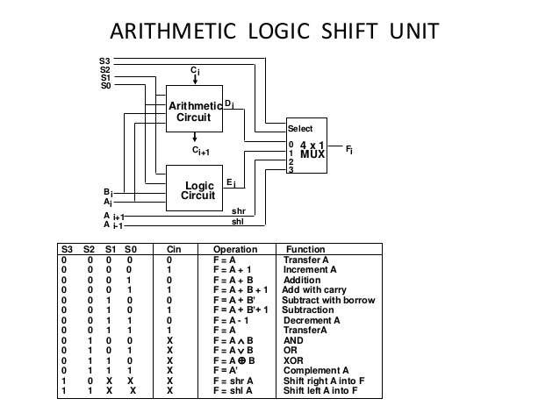
Arithmetic Logic Shift Unit (CO2)
Dr. RAJ KUMAR GOEL
AMCA-0104
UNIT-2

Slide 51

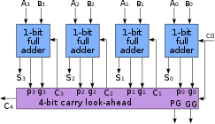
Design of Fast adders (CO2)
A carry-lookahead adder (CLA) or fast adder is a type of electronics adder used in digital logic. ... The carry-lookahead adder calculates one or more carry bits before the sum, which reduces the wait time to calculate the result of the larger-value bits of the adder.
Dr. RAJ KUMAR GOEL
AMCA-0104
UNIT-2

Slide 52

Binary adders (CO2)
➢A Binary Adder is a digital circuit that performs the arithmetic sum of two binary numbers provided with any length.
➢ A Binary Adder is constructed using full-adder circuits connected in series, with the output carry from one full-adder connected to the input carry of the next full-adder.
➢ The Add micro-operation requires registers that can hold the data and the digital components that can perform the arithmetic addition.
Dr. RAJ KUMAR GOEL
AMCA-0104
UNIT-2

Slide 53
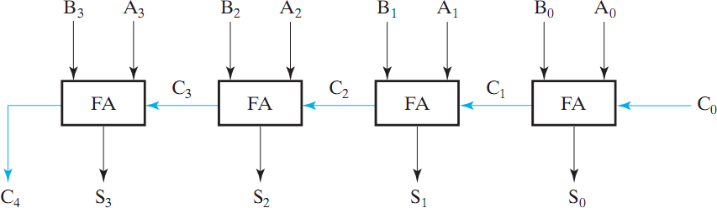
Binary adders (CO2)
➢The following interconnections
block diagram shows the of four full-adder circuits to
provide a 4-bit binary adder
Dr. RAJ KUMAR GOEL
AMCA-0104
UNIT-2

Slide 54

Binary adders
➢The augend bits (A) and the addend bits (B) are designated by subscript numbers from right to left, with subscript '0' denoting the low-order bit.
➢ The carry inputs starts from C0 to C3 connected in a chain through the full-adders. C4 is the resultant output carry generated by the last full-adder circuit.
➢ The output carry from each full-adder is connected to the input carry of the next-high- order full-adder.
➢ The sum outputs (S0 to S3) generates the required
a1/r19i/t20h22 metic sum ofDr.aRAuJ KUgMAeR GnOEdL anAMdCA-a010d4 denUNdIT-2 bits.
54

Slide 55
Binary adders
➢The n data bits for the A and B inputs come from different source registers.
➢For instance, data bits for A input comes from source register R1 and data bits for B input comes from source register R2.
➢ The arithmetic sum of the data inputs of A and B can be transferred to a third register or to one of the source registers (R1 or R2).
AMCA-0104
UNIT-2

Slide 56

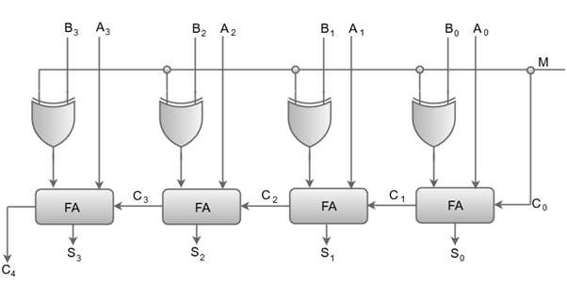
4-bit binary-adder subtractor
➢ The Arithmetic micro-operations like addition and subtraction can be combined into one common circuit by including an exclusive-OR gate with each full adder.
➢ The Binary Adder-Subtractor is a combination of 4 Full-Adder, which is able to perform the addition and subtraction of 4-bit binary numbers.
➢ The control line determines whether the operation being performed is either subtraction or addition. This determination is done by the binary values 0 and 1, which is hold by M
AMCA-0104
UNIT-2

Slide 57
4-bit binary-adder subtractor
➢ When the mode input (M) is at a low logic, i.e. '0', the circuit act as an adder and
when the mode input is at a high logic, i.e. '1', the circuit act as a subtractor.
➢ The exclusive-OR gate connected in series receives input M and one of the inputs B.
➢ When M is at a low logic, we have B⊕ 0 = B.
The full-adders receive the value of B, the input carry is 0, and the circuit performs A plus B.
➢ When M is at a high logic, we have B⊕ 1 = B' and C0 = 1. The B inputs are complemented, and a 1 is added through
the input carry. The circuit performs the operation A plus the 2's complement of B.
AMCA-0104
UNIT-2

Slide 58

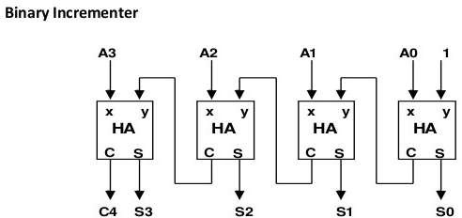
4-bit binary-Incrementer
The increment microoperation adds one to a number in a register. For example, if a 4-bit register has a binary value 0110, it will go to 0111 after it is incremented. The diagram of a 4- bit combinational circuit incrementer is shown in Fig.
AMCA-0104
UNIT-2

Slide 59

Shift microoperation
Shift microoperation can be used for serial transfer of data. They are used generally with the arithmetic, logic, and other data-processing operations. The contents of a register can be shifted to the left or the right. During a shift-right operation the serial input transfers a bit into the leftmost position. The serial input transfers a bit into the rightmost position during a shift-left operation. There are three types of shifts, logical, circular and arithmetic.
AMCA-0104
UNIT-2

Slide 60
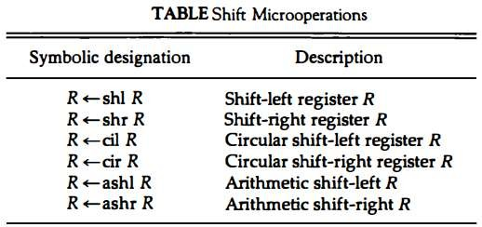
Shift microoperation
AMCA-0104
UNIT-2

Slide 61
Shift microoperation
A logical shift operation transfers 0 through the serial input. We use the symbols shl and shr for logical shift left and shift right microoperations, e.g.
R1 ← shl R1 R2 ← shr R2
are the two micro operations that specify a 1-bit shift left of the content of register R1 and a 1- bit shift right of the content of register R2.
AMCA-0104
UNIT-2

Slide 62
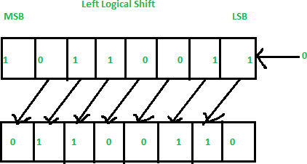
Shift microoperation
R1 ← shl R1
In this shift one position moves each bit to the left one by one. The Empty least significant bit (LSB) is filled with zero (i.e, the serial input), and the most significant bit (MSB) is rejected.
AMCA-0104
UNIT-2

Slide 63
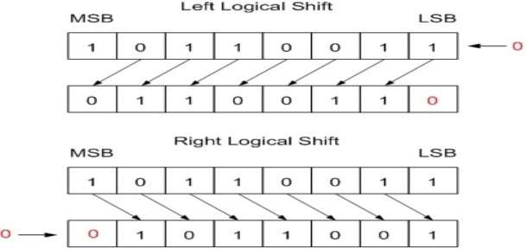
Shift microoperation
R2 ← shr R2
In this one position moves each bit to the right one by one and the least significant bit(LSB) is rejected and the empty MSB is filled with zero.
AMCA-0104
UNIT-2

Slide 64
Shift microoperation
The circular shift is also known as rotate operation. It circulates the bits of the register around the two ends and there is no loss of information. This is accomplished by connecting the serial output of the shift register to its serial input. We use the symbols cil and cir for the circular shift left and circular shift right.
AMCA-0104
UNIT-2

Slide 65
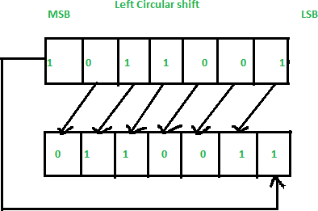
Shift microoperation
The circular shift circulates the bits in the sequence of the register around the both ends without any loss of information.
Left Circular Shift –
AMCA-0104
UNIT-2

Slide 66
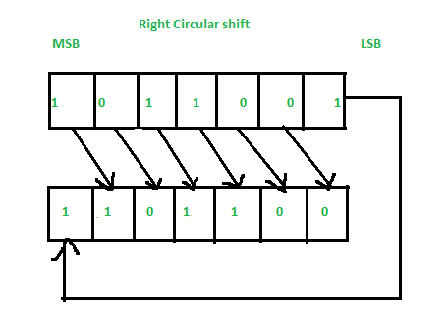
Shift microoperation
The circular shift circulates the bits in the sequence of the register around the both ends without any loss of information.
Right Circular Shift –
AMCA-0104
UNIT-2

Slide 67
Shift microoperation
An arithmetic shift micro operation shifts a signed binary number to the left or right. The effect of an arithmetic shift left operation is to multiply the binary number by 2.
Similarly an arithmetic shift right
divides the number by 2. Because the sign of the number must remain the same arithmetic shift-right must leave the sign bit unchanged, when it is multiplied or divided by
2. The left most bit in a register holds the sign bit, and the remaining bits hold the number. The sign bit is 0 for positive and 1 for negative. Negative numbers are in 2’s complement form.
AMCA-0104
UNIT-2

Slide 68
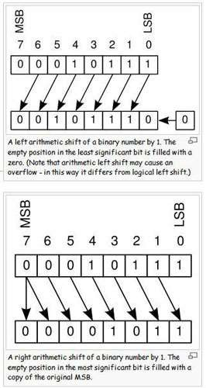
Shift microoperation
AMCA-0104
UNIT-2

Slide 69
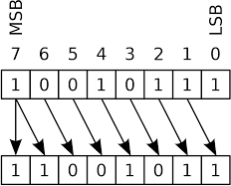
Shift microoperation
AMCA-0104
UNIT-2

Slide 70
Daily Quiz
1. A logic circuit that provides a HIGH output for both inputs HIGH or both inputs LOW is
a) Ex-NOR gate
b) OR gate
c) Ex-OR gate
d) NAND gate
AMCA-0104
UNIT-2

Slide 71
Daily Quiz
2. What is the major difference between half-adders and full-adders?
a) Full-adders are made up of two half-adders
b) Full adders can handle double-digit numbers
c) Full adders have a carry input capability
d) Half adders can handle only single-digit numbers
AMCA-0104
UNIT-2

Slide 72
Daily Quiz
3. The gates required to build a half adder are
a. EX-OR gate and NOR gate
b. EX-OR gate and OR gate
c. EX-OR gate and AND gate
d. EX-NOR gate and AND gate
AMCA-0104
UNIT-2

Slide 73
Daily Quiz
4. Two 4-bit binary numbers (1011 and 1111) are applied to a 4-bit parallel adder. The carry input is 1. What are the values for the sum and carry output?
a. Σ₄Σ₃Σ₂Σ₁ = 0111, C_{out} = 0
b. Σ₄Σ₃Σ₂Σ₁ = 1111, C_{out} = 1
c. Σ₄Σ₃Σ₂Σ₁ = 1011, C_{out} = 1
d. Σ₄Σ₃Σ₂Σ₁ = 1100, C_{out} = 1
AMCA-0104
UNIT-2

Slide 74
Daily Quiz
5. One way to make a four-bit adder perform subtraction is by:
a. inverting the output.
b. inverting the carry-in.
c. inverting the B inputs.
d. grounding the B inputs
AMCA-0104
UNIT-2

Slide 75
Daily Quiz
6. The binary adder circuit is designed to add
binary numbers at the same time.
a. 2
b. 4
c. 6
d. 8
AMCA-0104
UNIT-2

Slide 76
Daily Quiz
7. The binary adder circuit is designed to add
binary numbers at the same time.
a. 2
b. 4
c. 6
d. 8
AMCA-0104
UNIT-2

Slide 77
Daily Quiz
8. When the mode of adder subtractor is 1 then it :
a. Adds
b. Subtracts
c. Divides
d. Multiplie
AMCA-0104
UNIT-2

Slide 78
Daily Quiz
9. When the mode of adder subtractor is 0 then it :
a. Adds
b. Subtracts
c. Divides
d. Multiplie
AMCA-0104
UNIT-2

Slide 79
Daily Quiz
10. What is the sum(S) expression of a full adder if the inputs are A, B & C?
1) S = A OR B AND C
2) S = A AND B OR C
3) S = A XNOR B XOR C
4) S = A XOR B XOR C
AMCA-0104
UNIT-2

Slide 80
Daily Quiz
11. Arithmetic shift left operation
(A) Produces the same result as obtained with logical shift left operation.
(B) Causes the sign bit to remain always unchanged.
(C) Needs additional hardware to preserve the sign bit.
(D) Is not applicable for signed 2's complement representation.
AMCA-0104
UNIT-2

Slide 81
Daily Quiz
12. The negative numbers in the binary system can be represented by
(A) Sign magnitude
(B) I's complement
(C) 2's complement
(D) All of the above .
AMCA-0104
UNIT-2

Slide 82
Daily Quiz
13. In Boolean expression A+BC equals
A) (A+B)(A+C) (B) (A'+B)(A'+C)
(C) (A+B)(A'+C)
(D) (A+B)C
AMCA-0104
UNIT-2

Slide 83
Daily Quiz
14. RTL stands for:
A. Random transfer language
B. Register transfer language
C. Register transport language
D. None
AMCA-0104
UNIT-2

Slide 84
Daily Quiz
15.In register transfer the processor register as: A.MAR
B.PC
C. IR
D. RI
AMCA-0104
UNIT-2

Slide 85
Daily Quiz
16.Which operation is binary type, and are performed on bits string that is placed in register:
A. Logical micro operation
B. Arithmetic micro operation
C. Both
D. None
AMCA-0104
UNIT-2

Slide 86
Daily Quiz
17.Which operation is extremely useful in serial transfer of data:
A. Logical micro operation
B. Arithmetic micro operation
C. Shift micro operation
D. None of these
AMCA-0104
UNIT-2

Slide 87
Daily Quiz
18. Which shift is used for signed binary number:
a. Logical
b. Arithmetic
c. Both
d. None of these
AMCA-0104
UNIT-2

Slide 88
Daily Quiz
19.Which operation refer bitwise manipulation of contents of register:
A. Logical micro operation
B. Arithmetic micro operation
C. Shift micro operation
D. None of these
AMCA-0104
UNIT-2

Slide 89
Daily Quiz
20.
a. | 2
b. | 4
c. | 6
d. | 8
How many types of shift micro operation:
AMCA-0104
UNIT-2

Slide 90
Daily Quiz
20.
a. | 2
b. | 4
c. | 6
d. | 8
How many types of shift micro operation:
AMCA-0104
UNIT-2

Slide 91
Daily Quiz
21. A group of 4 binary bits is called:
A. Nibble
B. Byte
C. Decimal
D. Digit
AMCA-0104
UNIT-2

Slide 92
Daily Quiz
22. Shift left is equal to:
A. multiply by two
B. add by two
C. divide by two
D. subtract by two
AMCA-0104
UNIT-2

Slide 93
Daily Quiz
23. Micro operation is shown as:
a. R1→R2
b. R1←R2
c. Both
d. d. None
AMCA-0104
UNIT-2

Slide 94
Daily Quiz
1. An 8-bit register contains the binary value 10011100. What is the register value after an arithmetic shift right? Starting from the initial number 10011 100, determine the register value after an arithmetic shift left, and state whether there is an overflow.
2. Starting from an initial value of R =11011101, determine the sequence of binary values in R after a logical shift-left, followed by a circular shift-right, followed by a logical shift-right and a circular shift-left.
AMCA-0104
UNIT-2

Slide 95
Recap
In the last lecture we have discussed about
Arithmetic, logic and shift microoperations, their hardware
construction and construction of fast adders.
AMCA-0104
UNIT-2

Slide 96


Faculty Video Links, YouTube & NPTEL Video Links and Online Courses Details
➢ YouTube/other Video Links
➢ https://www.webopedia.com/quick_ref/computer-architecture- study-guide.html
➢ https://www.youtube.com/watch?v=RAeXWjPMRVM
➢ https://www.youtube.com/watch?v=HKmWvlrrN3M
➢ https://www.youtube.com/watch?v=DHhcnjEKEFo
AMCA-0104
UNIT-2

Slide 97

Multiple Choice Questions
1. The standard SRAM chips are costly as
a) They use highly advanced micro-electronic devices
b) They house 6 transistor per chip
c) They require specially designed PCB’s
d) None of the mentioned
2. The drawback of building a large memory with DRAM is
a) The large cost factor b) The inefficient memory organization
c) The Slow speed of operation d) All of the mentioned
3. To overcome the slow operating speeds of the secondary
memory we make use of faster flash drives.
a) True b) False
4. The fastest data access is provided using
a) Caches b) DRAM’s c) SRAM’s d) Registers
AMCA-0104
UNIT-2

Slide 98
Multiple Choice Questions
5. The memory which is used to store the copy of data or instructions stored in larger memories, inside the CPU is called
a) Level 1 cache b) Level 2 cache c) Registers d) TLB
6. The larger memory placed between the primary cache and the memory is called
a) Level 1 cache b) Level 2 cache c) EEPROM d) TLB
7. The next level of memory hierarchy after the L2 cache is
a) Secondary storage b) TLBc) Main memory d) Register
8. The last on the hierarchy scale of memory devices is
a) Main memory
c) TLB
b) Secondary memory
d) Flash drives
AMCA-0104
UNIT-2

Slide 99

Glossary
1. Single choice questions (11111111, Registers, Store
Accumulator, 01000)
a. The ALU gives the output of the operations and the output is stored in the
b. The bitwise complement of 0 is .
c. The result of >> of 11001 by 3-bits will be
d. What does the data transfer instruction STA stand for……..
AMCA-0104
UNIT-2

Slide 100
Glossary
2. (Micro program , Vertical Microinstruction, Sequencing, Hardwired)
a. If the control signals are generated by combinational logic, then they are generated by a type of controlled unit.
b. A set of microinstructions for a single machine instruction is called
c. A decoder is required in case of a
d. Causing the CPU to step through a series of micro operations is called .
AMCA-0104
UNIT-2

Slide 101

Old Question Papers
➢ http://www.aktuonline.com/papers/mca-1-sem-computer- organization-and-architecture-AMCA-0104-2018-19.html
➢ http://www.aktuonline.com/papers/mca-1-sem-computer-
organization-and-architecture-AMCA-0104-2017-18.html
➢ http://www.aktuonline.com/papers/mca-1-sem-computer-
organization-and-architecture-AMCA-0104-2016-17.html
AMCA-0104
UNIT-2

Slide 102
Expected Questions for University Exam
Q-1. Explain about the following.
•Multiplexer
•Decoder
•Register
•Counter
Q-2. Explain the functionality of Half adder and Full adder using truth
table and Logic diagrams.
Q-3. Differentiate between Combinational and Sequential circuits
using suitable diagrams and examples.
Q-4 Make a table for binary codes that shows BCD, 2421, Excess-3
and 8,4,-2,-1 codes.
Q-5. Explain all logic gates with symbol, algebraic expression and truth table.
AMCA-0104
UNIT-2

Slide 103

Summary
1. A digital system is an interconnection of digital hardware modules that accomplish a specific information processing task.
2. Digital system design uses a modular approach. The modules are constructed from digital components like registers, decoders, arithmetic elements and control logic.
3. The various modules are interconnected with common data and control paths to form a digital computer system.
4. Bus may be constructed either by using multiplexers or three
state buffers.
AMCA-0104
UNIT-2

Slide 104


References
1. Logic and Digital Design, Morris mano and Kimicharels 4th
Edition, Prentice Hall.
2.Computer System Architecture, M.Mano(PHI)
3.Computer Organization, Vravice, Zaky&Hamacher
Publication)
4. Structured Computer Organization, Tannenbaum(PHI)
5. Computer Organization, Stallings(PHI)
6. Computer Organization, John P.Hayes (McGraw Hill)
(TMH
AMCA-0104
UNIT-2

